Slide 1


CREDIT CARD FRAUD DETECTION
Using Machine Learning & Deep Learning Techniques
Prepared By: Group-11 (Saba Zulfiqar, Manal Shahzad, Ifra Altaf)
Submitted To: Dr. Nadeem Iqbal, Institute of Computing, Muhammad Nawaz Sharif University of Agriculture Multan

Slide 2


Executive Summary: Fraud Detection
This report details a Credit Card Fraud Detection system using ML and DL techniques to identify fraudulent transactions in highly imbalanced datasets.
1
2
Dataset Challenge
Techniques Used
284,807 transactions with only 492 (0.17%) fraudulent cases.
NearMiss undersampling & SMOTE oversampling.
3
Models Trained
Logistic Regression, Random Forest, Neural Networks.

Slide 3




Key Achievements & Workflow
Random Forest + SMOTE
Neural Network
Key Indicators
Achieved an impressive ROC-AUC of 0.999 (99.9%).
Demonstrated 100% test accuracy with perfect fraud detection.
V14, V12, V10, V17 identified as crucial negative correlation features.
01
02
Data Understanding
Preprocessing
EDA & visualizations revealed 0.17% fraud rate.
Scaling & stratified splitting for standardized features.
03
04
Sampling
Modeling & Evaluation
NearMiss & SMOTE for balanced datasets.
LR, RF, NN, evaluated with ROC-AUC, PR curves, Confusion Matrix.

Slide 4

Problem & Objectives
Problem Statement
Objectives
Credit card fraud costs billions. Traditional rule-based systems fail against evolving patterns. ML offers a data-driven approach, but extreme class imbalance (99.83% vs 0.17%) is a major challenge.
Perform comprehensive EDA to understand data.
Handle extreme class imbalance using sampling techniques.
Train Logistic Regression, Random Forest, and Neural Network models.
Compare model performances using ROC-AUC, Precision-Recall, and Confusion Matrix.

Slide 5

Dataset Overview
The Kaggle Credit Card Fraud Detection dataset contains European cardholder transactions from September 2013 over two days.
Total Transactions
284,807
Complete dataset size
Fraudulent
492 (0.17%)
Minority class
Non-Fraudulent
284,315 (99.83%)
Majority class
Features
31
Input features + target
Missing Values
0
Complete dataset
A naive model predicting all 'No Fraud' achieves 99.83% accuracy but detects ZERO frauds! This highlights the need for specialized metrics and techniques.

Slide 6
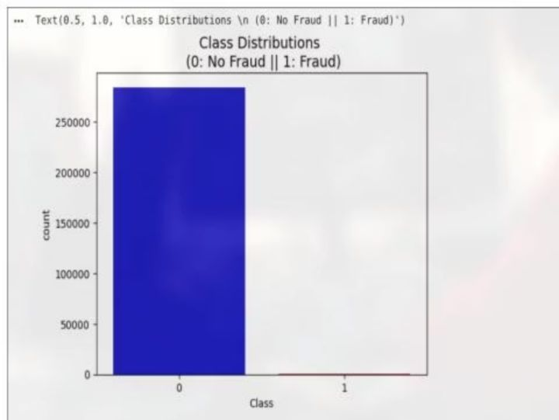
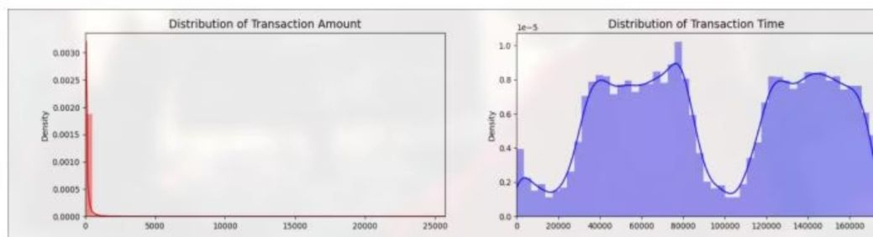
Exploratory Data Analysis (EDA)
EDA reveals data structure, patterns, and anomalies crucial for modeling decisions.
Class Distribution
Transaction Distributions
Amount: Highly right-skewed, most transactions are small. Time: Bimodal, indicating two days of data with fewer nighttime transactions.
Dramatic visualization of 578:1 class imbalance. Class 0 (No Fraud) dominates with ~284,000 transactions, while Class 1 (Fraud) has only 492.

Slide 7
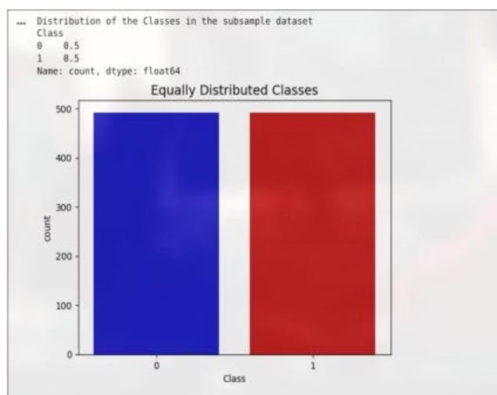

Data Preprocessing & Imbalance Handling
V1-V28 are PCA-scaled; we scaled Time and Amount. Stratified K-Fold ensures class proportions are maintained in splits.
Scaled Features
Balanced Subsample (NearMiss)
StandardScaler applied to 'Amount' and 'Time', creating 'scaled_amount' and 'scaled_time'. This ensures all features contribute equally.
NearMiss undersampling created a perfectly balanced dataset with 492 fraud and 492 non-fraud samples.

Slide 8
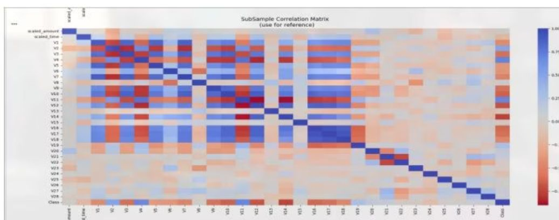
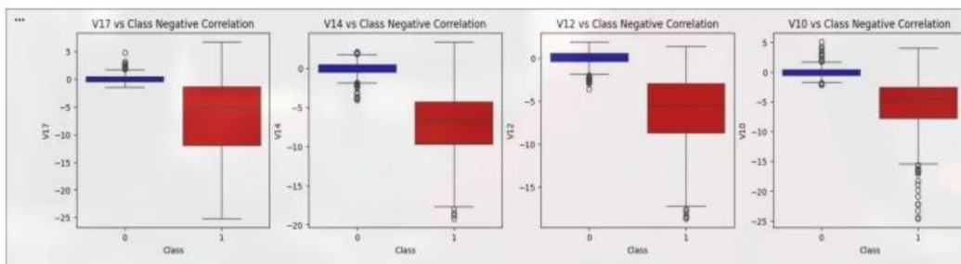
Feature Analysis & Correlation
Analyzing correlations helps identify features most indicative of fraud.
Balanced Correlation Matrix
Key Fraud Indicators
V17, V14, V12, V10 show strong negative correlation; lower values indicate higher fraud probability. V11, V4, V2, V19 show positive correlation.
With balanced data, true correlations emerge. Features show clear positive (dark blue) and negative (dark red) correlations with fraud.

Slide 9
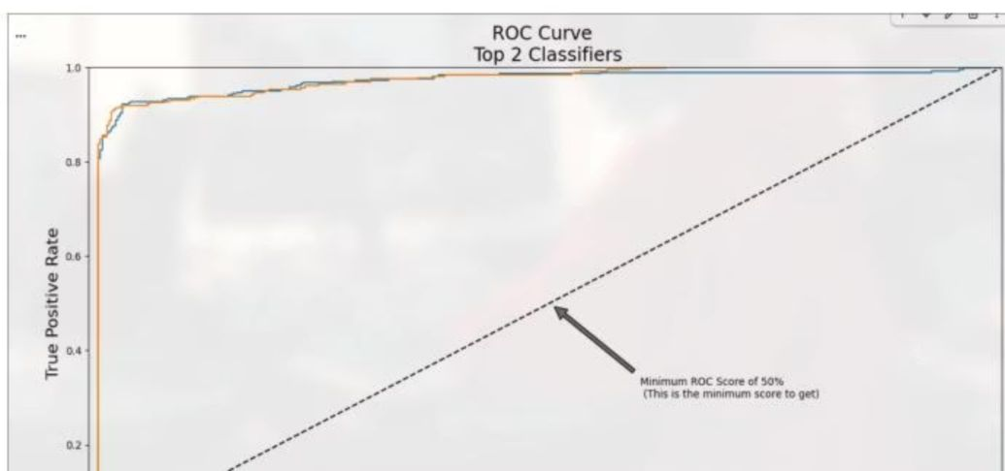
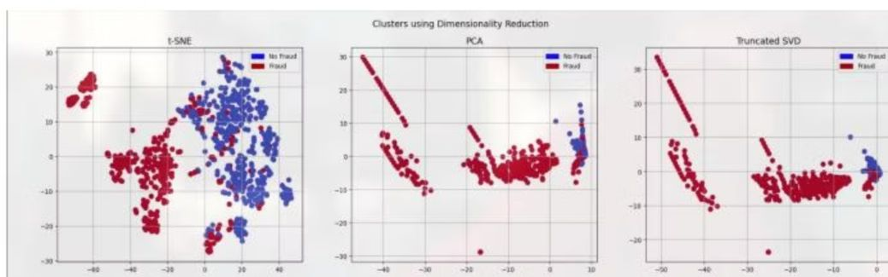
Dimensionality Reduction & Model Training
Dimensionality reduction visualizes data, while models learn fraud patterns.
Clusters using Dimensionality Reduction
ROC Curve Visualization
t-SNE shows distinct, well-separated fraud clusters, confirming ML can distinguish them. PCA and Truncated SVD also show separability.
Both Logistic Regression (0.9728) and Random Forest (0.9765) show excellent ROC-AUC scores, significantly outperforming random chance.

Slide 10
Deep Learning & Results Comparison
Neural Networks achieve remarkable performance, especially with SMOTE.
Neural Network Architecture
Perfect Classification
SMOTE Neural Network
Neural Network (undersampled) achieved 100% accuracy on the full test set (56,961 samples), with zero false positives and false negatives.
Training on SMOTE data led to 99.98% accuracy and 100% validation accuracy, with extremely low loss.
A lightweight sequential model with 3 dense layers and 1,988 trainable parameters.
Best Models
1
2
Neural Network (Undersampled)
Random Forest + SMOTE
100% Accuracy, 0 FP, 0 FN.
ROC-AUC 0.9991.

